Slide 1

CMP4272 Data Structures and Algorithms
Week 1

Slide 2
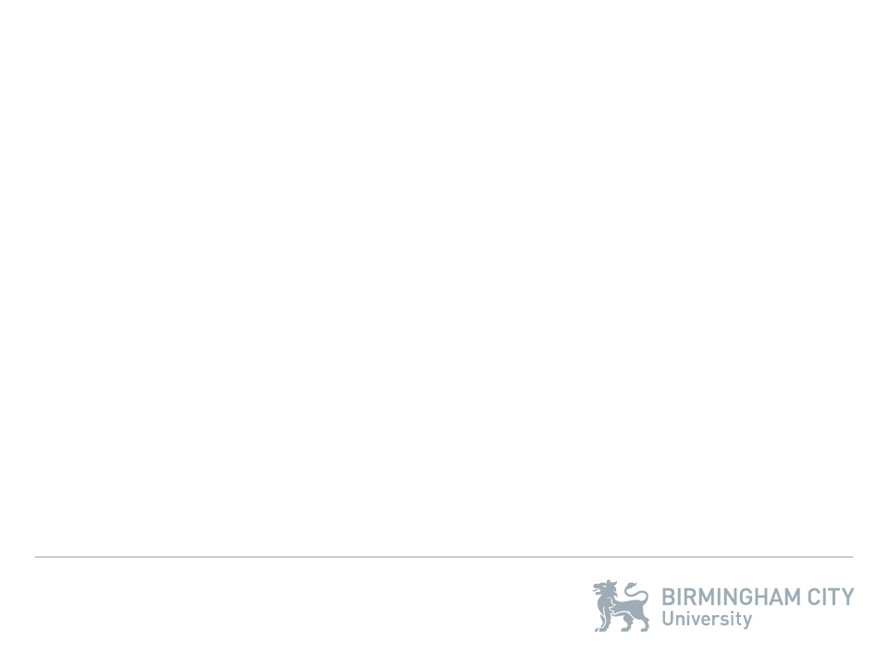
Who am I?
Iain Rice – Lecturer
BSc Mathematics & Business Administration, Aston University
PhD Applied Mathematics, Aston University
Head of School Computing & IT, Arden University
Senior Lecturer, Birmingham City University
Iain.Rice@bcu.ac.uk

Slide 3
What’s the point of this module?
1) Do not pass go, do not collect £200…
2) Wait and see!
3) Core content is fixed, context is flexible!
Notes:
Is a joke on Monopoly – you have to pass the module to proceed with your studies, but beyond this it is a fundamental part of computer systems and programming to understand data structures and algorithms. 3) is an important point to make, we have to cover the core content to meet the assignment briefs and learning outcomes for the module, but the context within which this is taught – the examples and class activities – can be adapted. If you want to see how the concepts can be applied to a particular area then let us know, we’ve got some group activities based on identifying terrorist cells and looking into how to win an election for example.

Slide 4
Slides
Theory
Employability
Practical
Assessment
Notes:
Note the colour of the slides– a helpful indicator for what to do. In the practical slides you need to be doing things, not just sat around waiting for the lecturer or demonstrator to give you the answer!

Slide 5
What about when I get stuck?
Notes:
This is a really important point for the class to understand: if you have a question then just ask it! On the left we have a picture of a woman, Kitty Genovese, who in 1964 was murdered by Winston Mosley, on the right. She was stabbed outside an apartment block opposite where she lived, above a row of shops. This murder was witnessed by at least 38 different people, as claimed by the New York Times two weeks later, but nobody called the police. They claimed since other people had also witnessed it that they themselves did not call the police. Winston was in fact arrested six days later during a house burglary and confessed to the murder. Not acting because you expect others to has been termed ‘The Bystander Effect’ and is well studied in Sociology and Psychology. So – if any of the class has a question then you must ask it, don’t expect someone else to!

Slide 6
Help…
1) Online Slides
a) Online Activities
Recommended Reading
- Additional Activities
* Each Other
i. timetabled sessions, email or group support appt.
Notes:
This is a SET (we’ll cover this in more detail later) of help tools, not an ordered list!

Slide 7
Help…
Fake News
Notes:
This is to show that students must be careful with their sources when getting information. The ‘fact’ shown here has been publicized in many different places, but it is actually fake news! NASA actually spent $4,382.50 on the pens which were later sold at a reduced price of less than $4 per pen. The reason for using the pens instead of pencils is that pencils contain graphene, a superconductor which flakes easily, so this could wreak havoc in space when the particles got into the filters and circuitry as well as being ingested by the astronauts.

Slide 8
Assessment
1) Job Application in Week 7
2) Interview in Week 11
3) Assessment Centre in Week 13
More details to come…

Slide 9
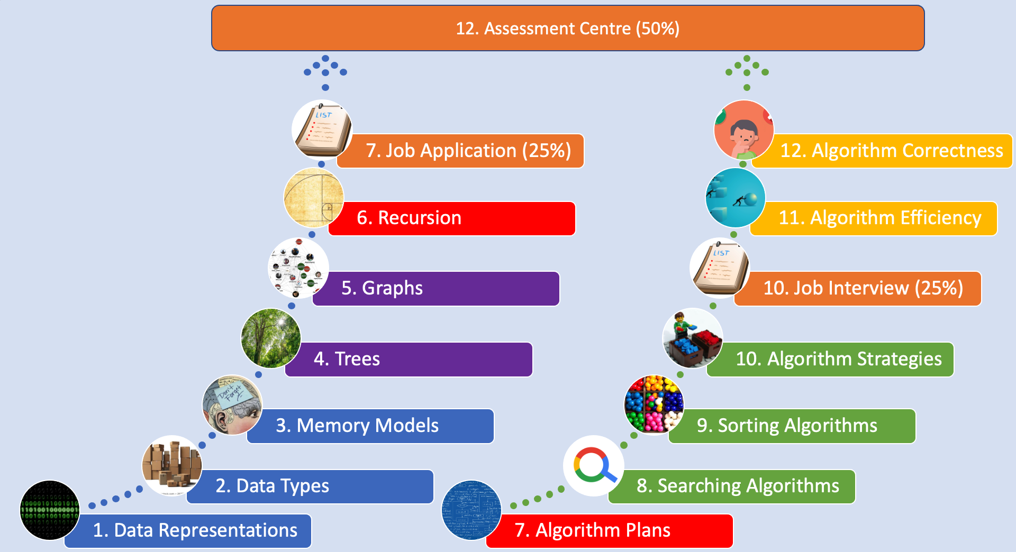
Module Structure (Technical)

Slide 10
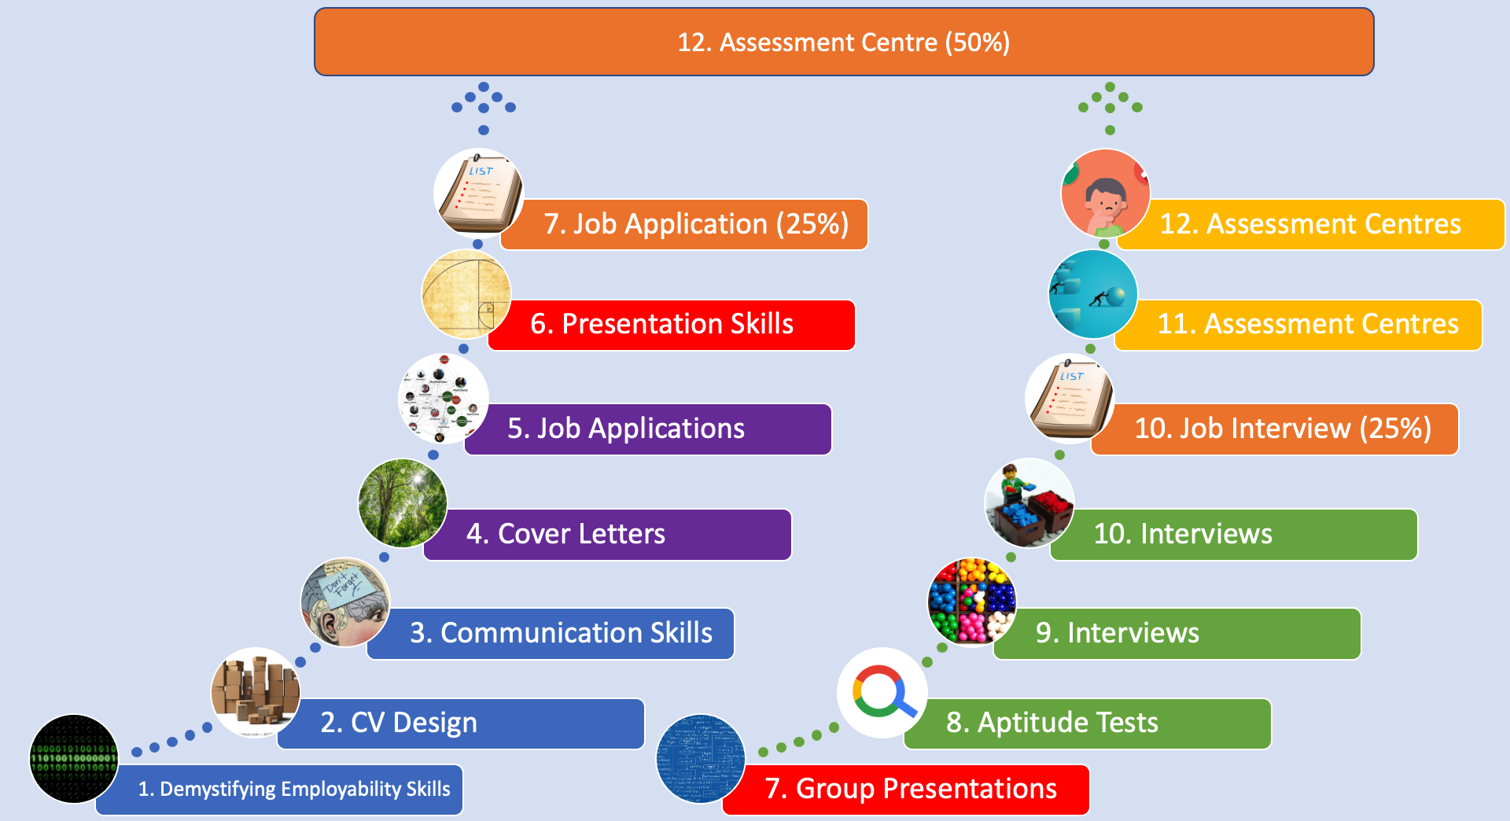
Module Structure (Employability)

Slide 11
Week 1 Class 1: Lesson in 10, 9, 8…
Notes:
Today we’re covering structures, not these but data structures, as well as defining algorithms, then looking at binary numbers and how we implement them in python.

Slide 12
Data Structures & Algorithms
Data structure: how data is represented
Algorithm: how data is operated
“I will, in fact, claim that the difference between a bad programmer and a good one is whether he considers his code or his data structures more important. Bad programmers worry about the code. Good programmers worry about data structures and their relationships.” – Linus Torvalds

Slide 13
Data Structures & Algorithms
Gives an understanding, in depth, how computer gets things done.
Help to decide on hardware requirements.
What is feasible vs what is impossible.
Improvement is a never-ending process.

Slide 14
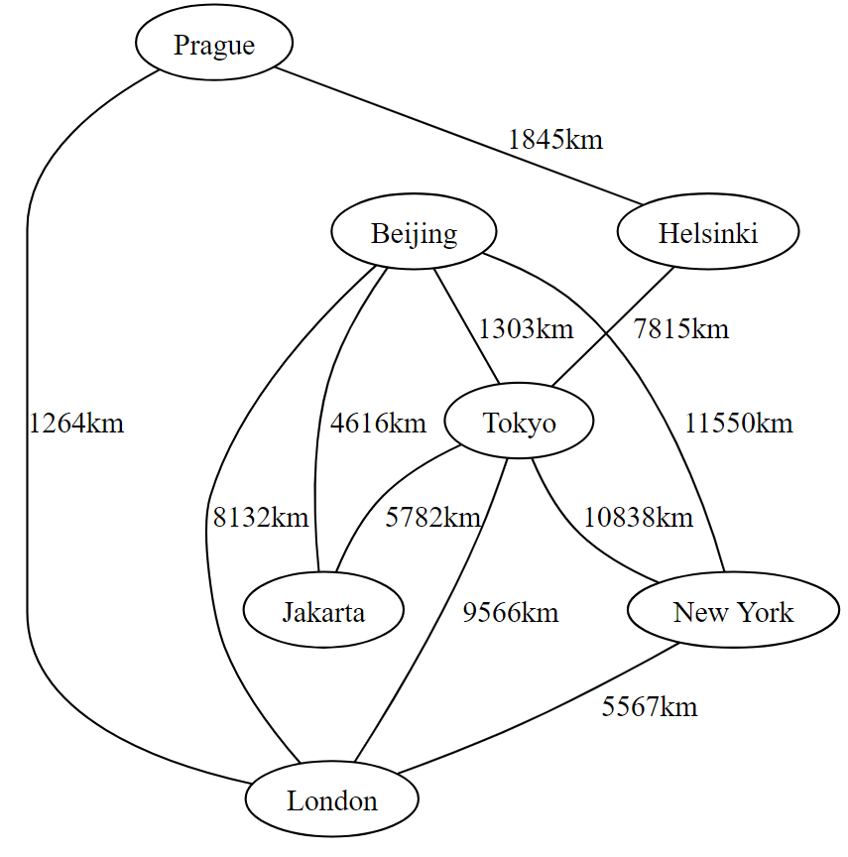
Based on this graph, how can we find the shortest distance from Helsinki to London?
Graphs
Dijkstra’s Algorithm

Slide 15
Data Structures
In computer science, a data structure is a particular way of organizing and storing data in a computer so that it can be accessed and modified efficiently.
Tools to develop a program
A data structure strives to provide many useful, efficient operations
But there are unavoidable trade-offs:
Time vs. space
One operation more efficient if another less efficient – Generality vs. simplicity vs. performance
Ask yourself:
Does this support the operations I need efficiently?
Will it be easy to use (and reuse), implement, and debug?

Slide 16
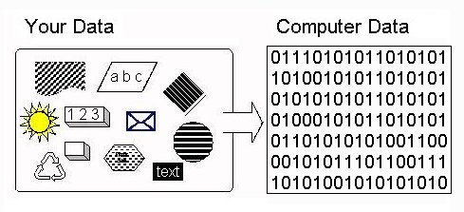
Data Representation in Computers
Whatever type of data we’re dealing with, the data has to be represented in the computer somehow, otherwise we can’t compute with it.
But computers don’t have different processors for calculating with numbers and strings, nor do they have separate memory for different data types.
How the computer recognizes this data, how the data is represented in computers.
The computer can only recognize two numbers, 0 for OFF, and 1 for ON, which can be referred to as BIT.
Hence computers can be said to be discrete machines. Quantum Computers exist in a continuous state without fixed bits.

Slide 17
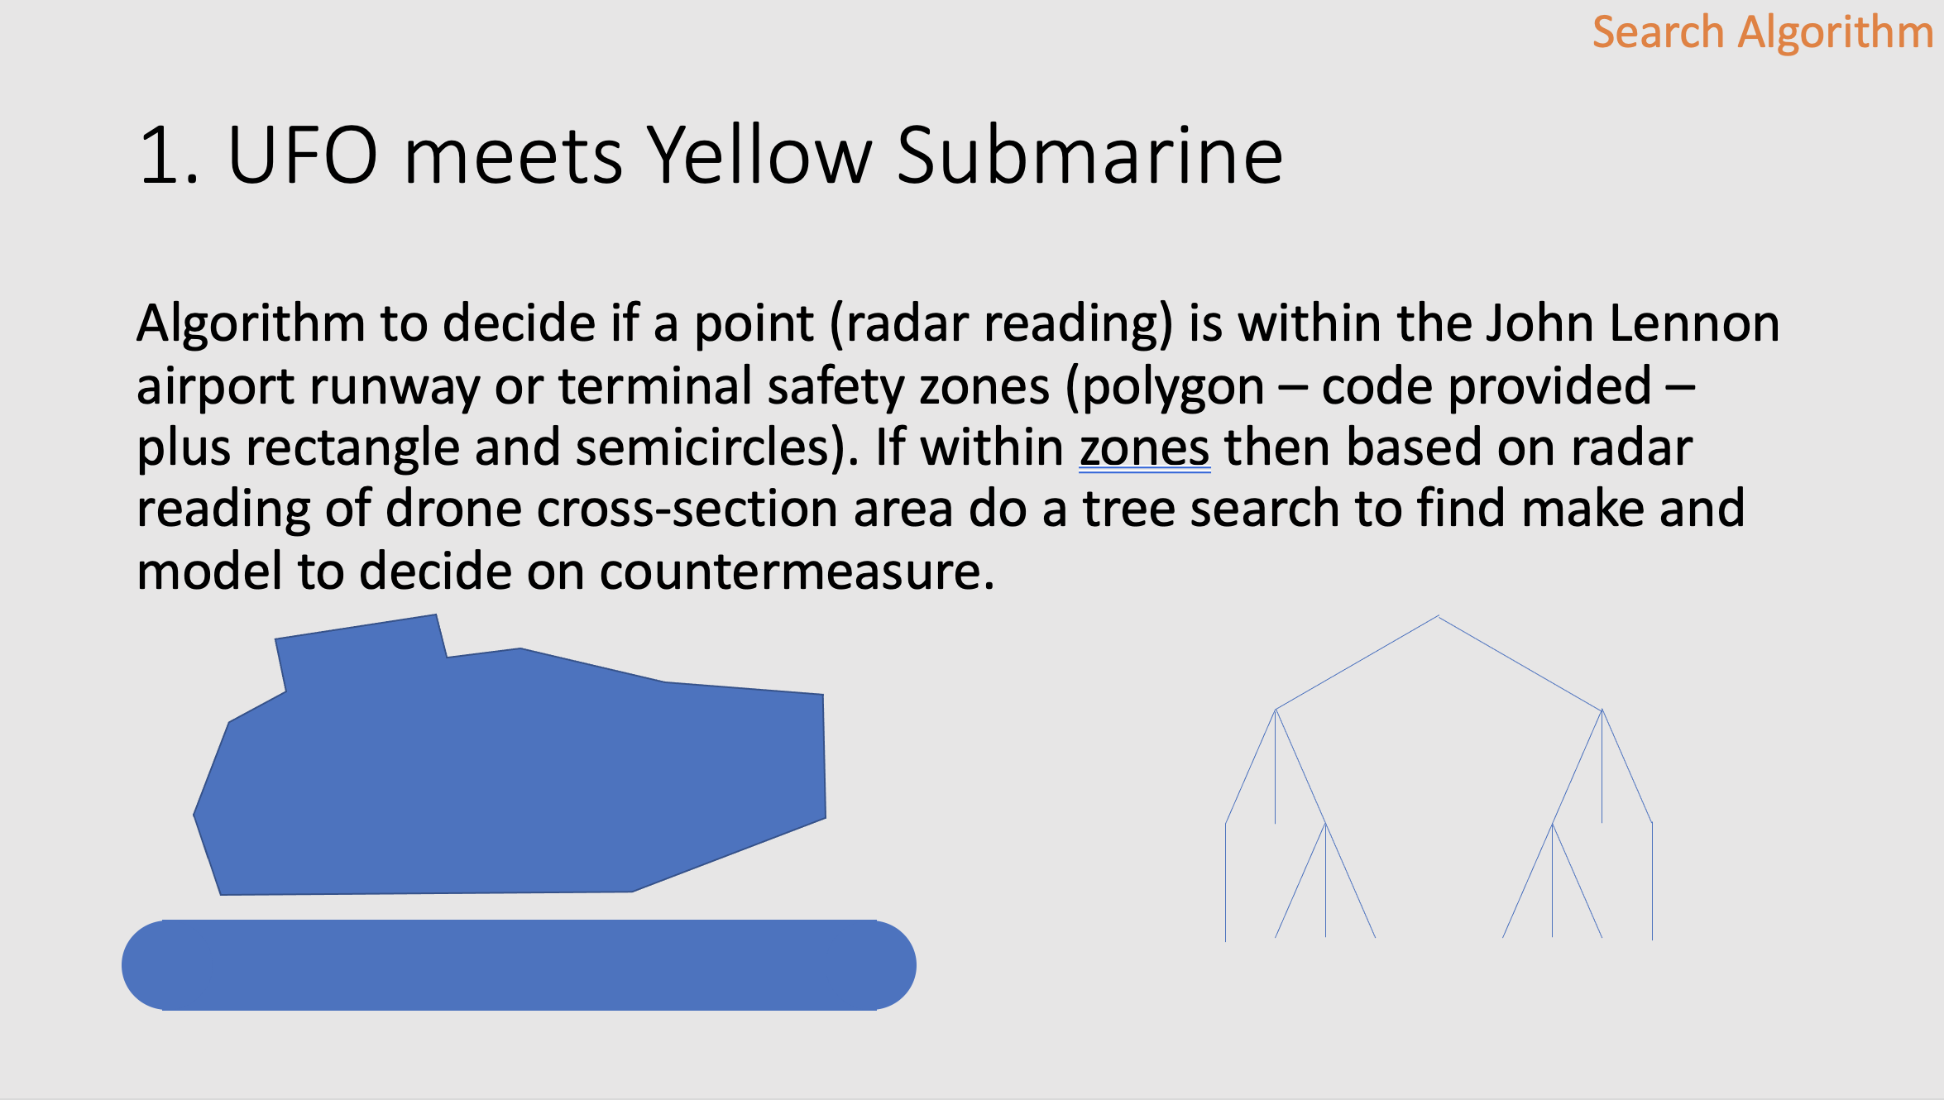
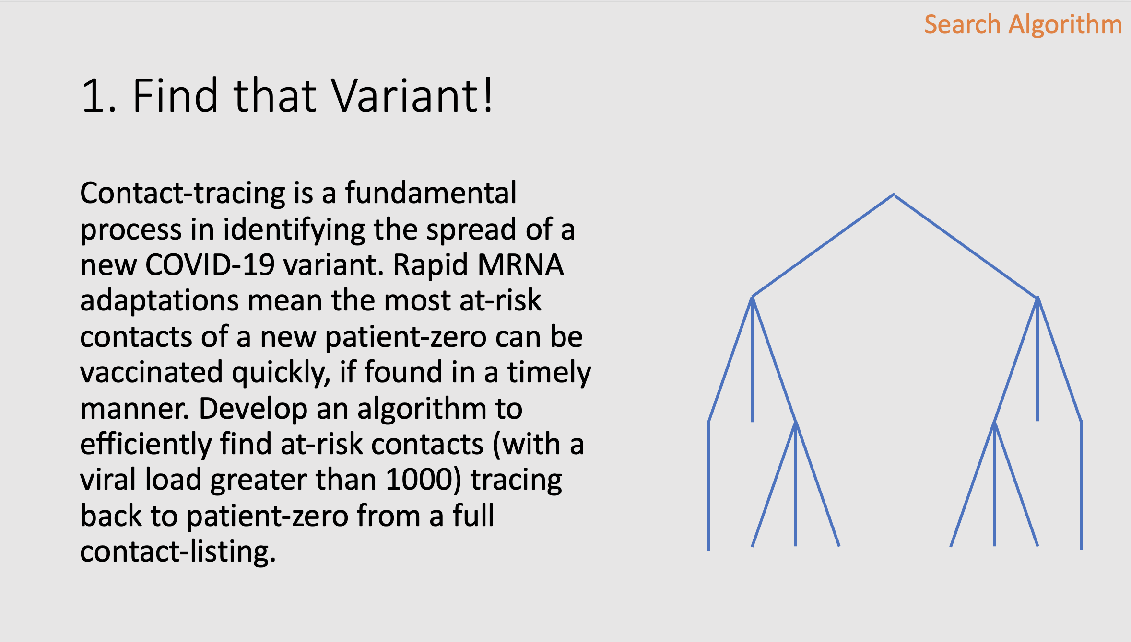
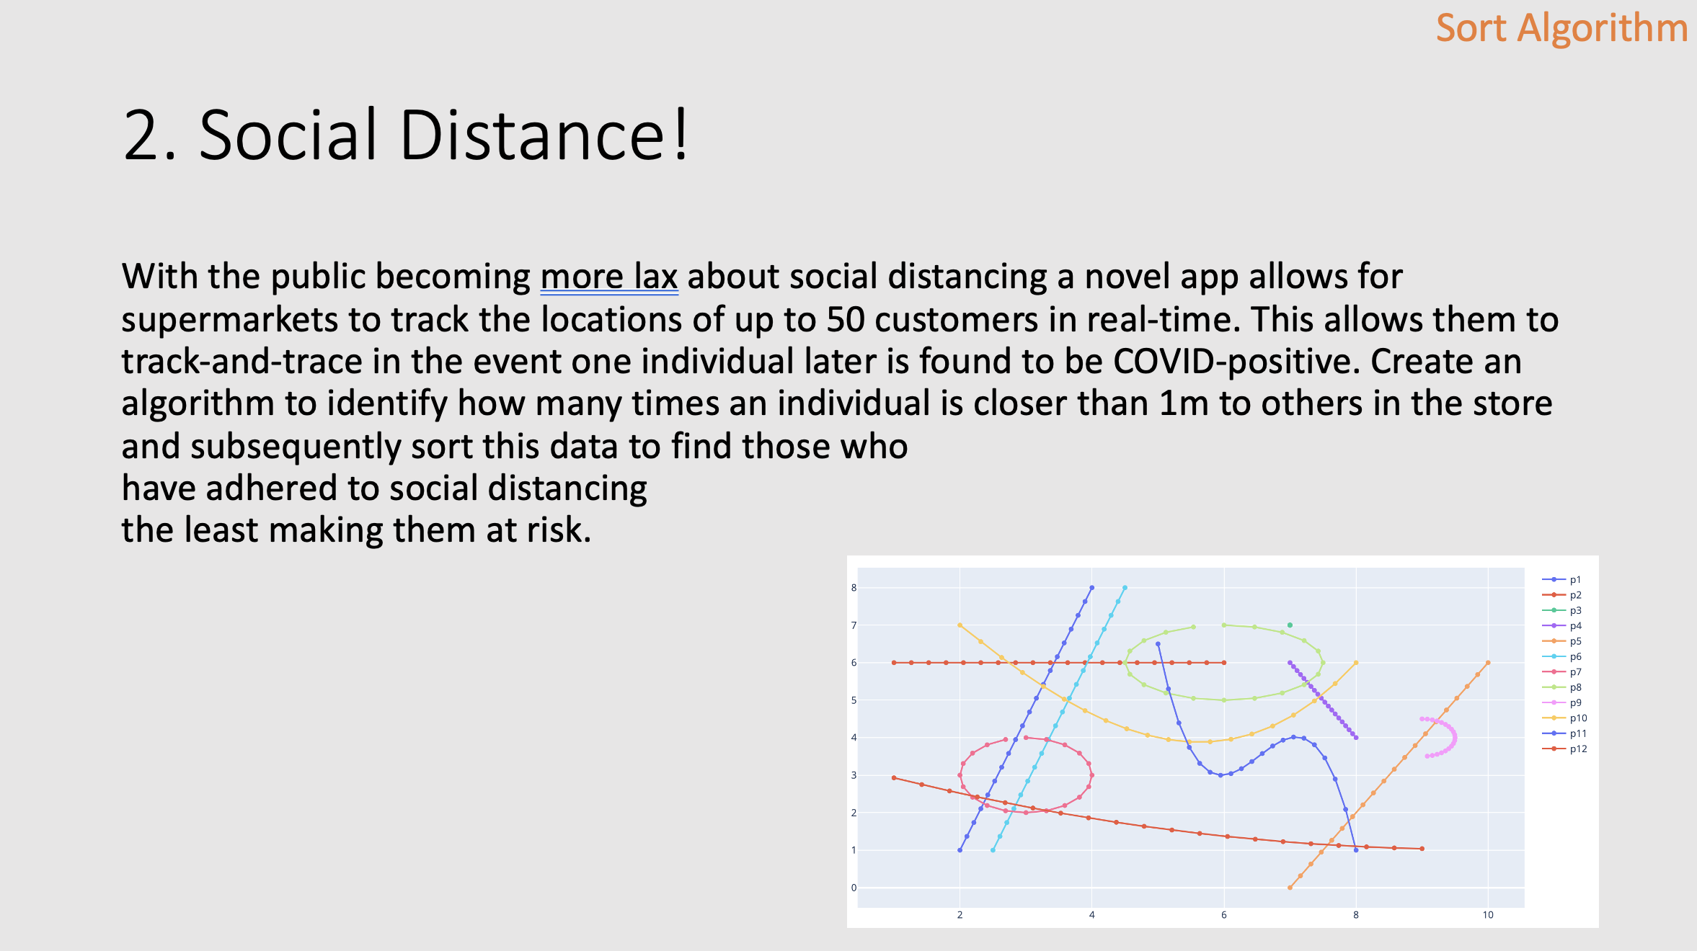
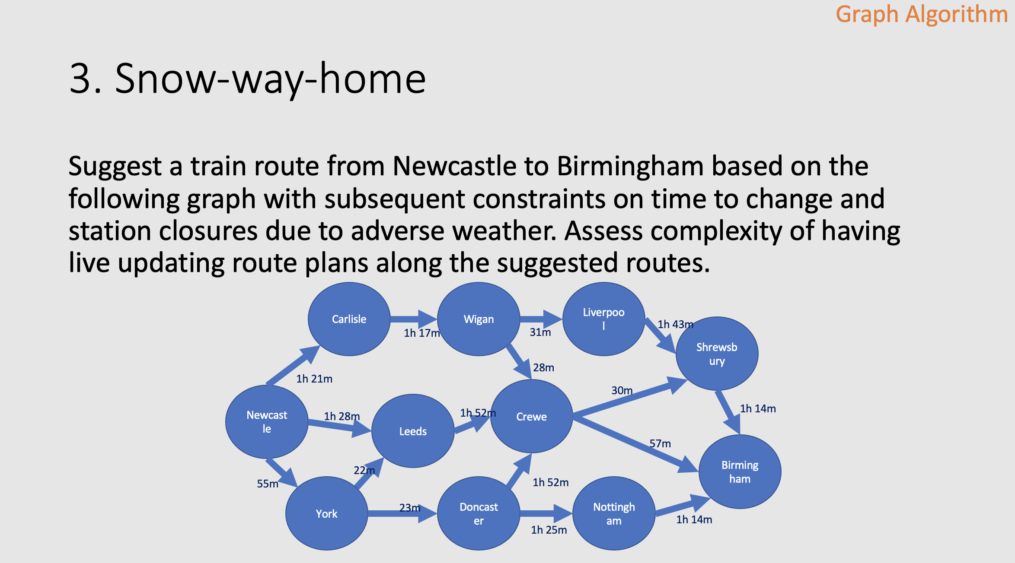
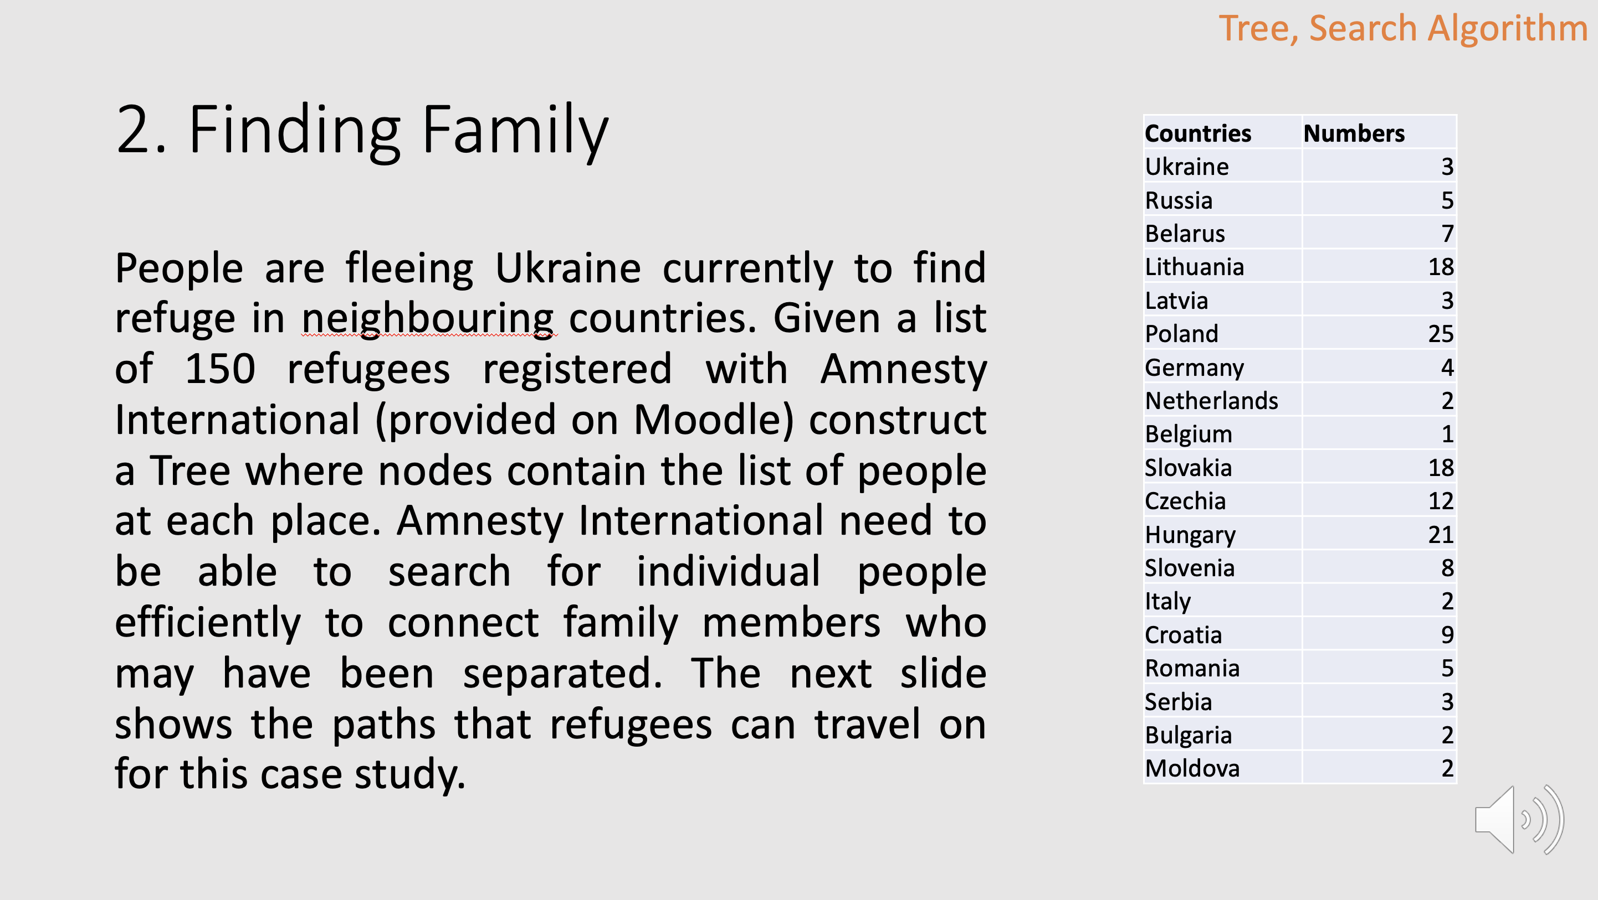
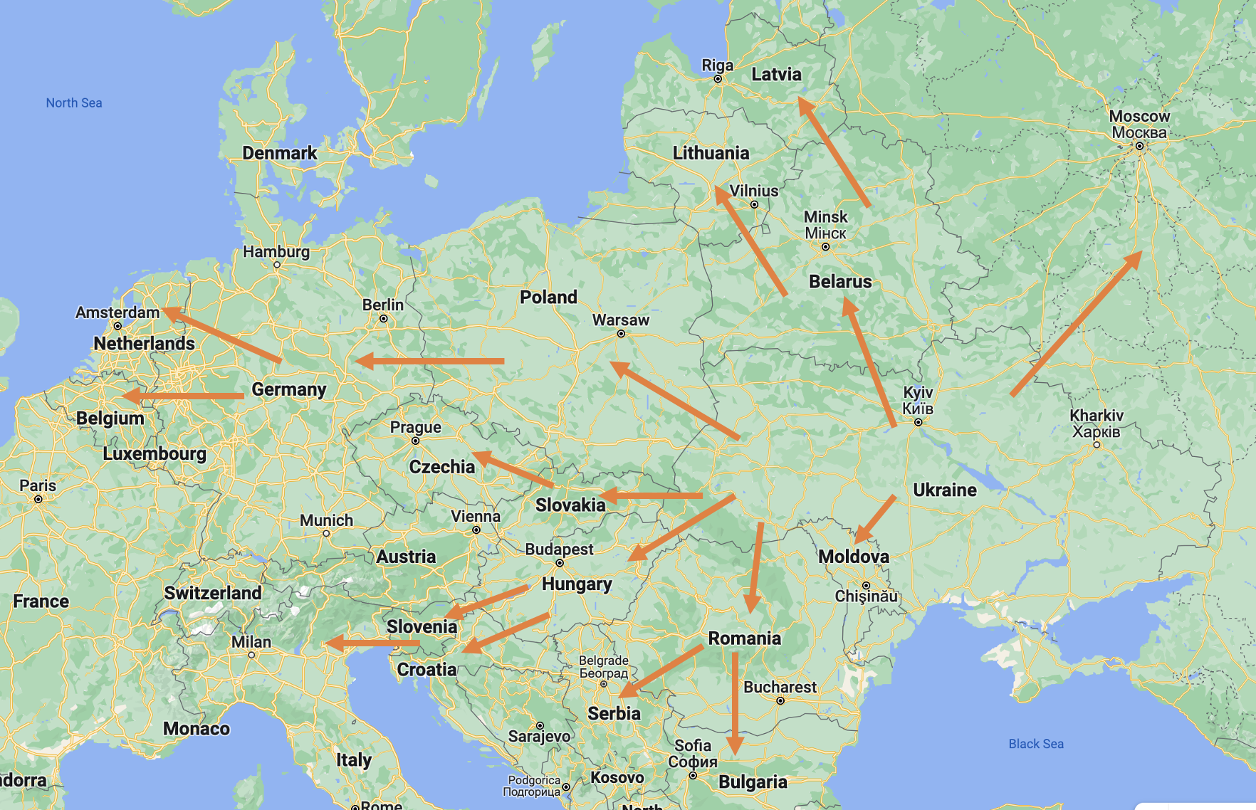
What you can do with Data Structure and Algorithm knowledge

Slide 18
Why Use Binary?
The computer is a two-state (binary) machine. All components inside a computer and all backing storage devices have only two states. e.g.
a switch is on or off.
a transistor conducts or does not conduct.
a signal is a pulse of electricity or no pulse.
an area of a magnetic disk is positive or negative.
with laser technology light can reflect in two different directions.

Slide 19
Why Use Binary?
Binary (using the numbers 0 and 1) can be represented by a two-state system. Then, when we need to store some data, there are two questions:
How do we use them to represent the value we want to store
How many switches (bits) do we need to represent this data type?

Slide 20
How to present integers in bits
Solving this problem requires deciding on a scheme for what the bits should mean. Whatever scheme you come up with, you’ll have to use it consistently, and so will whoever else needs to make sense of your data.
Example 1: Tally scheme - the number represented by a sequence such as 10110011 is simply the number of 1 bits, so in this case it would be 5.

Slide 21
How to present integers in bits
Solving this problem requires deciding on a scheme for what the bits should mean. Whatever scheme you come up with, you’ll have to use it consistently, and so will whoever else needs to make sense of your data.
Example 2: Base 2 representation - how computers represent numbers. The rightmost bit means 1, the next bit left means 2, the next bit left means 4, and so on… the rest are 8, 16, 32, 64, 128. The number represented is the sum of the values of the bits which are 1. So for example, the bits 01001100 mean 64 + 8 + 4 = 76.

Slide 22
Number Systems
0:9 # 10¹
10:99 ## 10²
100:999 ### 10³
1,000:9,999 #### 10⁴
Base 10
0,1,2,3,4,5,6,7,8,9

Slide 23
0:1 # 2¹
0:1
2:3 ## 2²
10:11
4:7 ### 2³
100:111
8:15 #### 2⁴
1000:1111
16:31 ##### 2⁵
10000:11111
32:63 ###### 2⁶
100000:111111
Number Systems
Base 2
0, 1

Slide 24
0:1 # 2¹
0:1
2:3 ## 2²
10:11
4:7 ### 2³
100:111
8:15 #### 2⁴
1000:1111
16:31 ##### 2⁵
10000:11111
32:63 ###### 2⁶
100000:111111
What is 010101
in base 10?
Range?
16:31

Slide 25
0:1 # 2¹
0:1
2:3 ## 2²
10:11
4:7 ### 2³
100:111
8:15 #### 2⁴
1000:1111
16:31 ##### 2⁵
10000:11111
32:63 ###### 2⁶
100000:111111
What is 010101
in base 10?
Count on?
16 = 010000
17 = 010001
18 = 010010

Slide 26
0:1 # 2¹
0:1
2:3 ## 2²
10:11
4:7 ### 2³
100:111
8:15 #### 2⁴
1000:1111
16:31 ##### 2⁵
10000:11111
32:63 ###### 2⁶
100000:111111
What is 010101
in base 10?
Convert?
= 10000 + 100 + 1
= 16 + 4 + 1
= 21

Slide 27
0:1 # 2¹
0:1
2:3 ## 2²
10:11
4:7 ### 2³
100:111
8:15 #### 2⁴
1000:1111
16:31 ##### 2⁵
10000:11111
32:63 ###### 2⁶
100000:111111
What is 1110
in base 10?
1110 = 14

Slide 28
0:1 # 2¹
0:1
2:3 ## 2²
10:11
4:7 ### 2³
100:111
8:15 #### 2⁴
1000:1111
16:31 ##### 2⁵
10000:11111
32:63 ###### 2⁶
100000:111111
What is 19
in base 2?
19 = 10011

Slide 29
19 / 2 = 9 remainder 1
9 / 2 = 4 remainder 1
4 / 2 = 2 remainder 0
2 / 2 = 2 remainder 0
1 / 2 = 0 remainder 1
Binary = 1 0 0 1 1
Easy converting from base 10 to base 2
Continually divide the decimal number by 2

Slide 30
117 / 2 = 58 remainder 1
58 / 2 = 29 remainder 0
29 / 2 = 14 remainder 1
14 / 2 = 7 remainder 0
7 / 2 = 3 remainder 1
3 / 2 = 1 remainder 1
1 / 2 = 0 remainder 1
Binary = 1 1 1 0 1 0 1
Exercise: Convert 117 from base 10 to base 2
Continually divide the decimal number by 2

Slide 31
Data Representations
There is a unique representation for each number! (1-2-1 mapping). The smallest unit in the computer's memory to store data is called a BYTE, which consists of 8 BITS.
One Byte allows up to 256 different combinations of data representation (2⁸= 256).
What happens when we have numbers greater than 256?
The computer simply uses more Bytes to hold the value, 2 Bytes can hold values up to 65536 (216) and so forth.

Slide 32
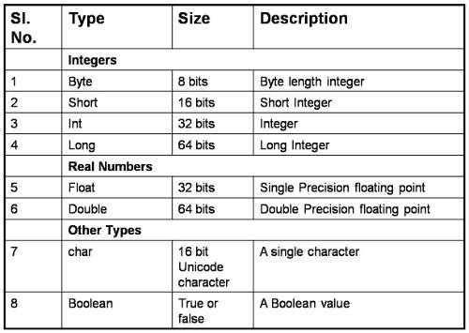
Data Representations

Slide 33
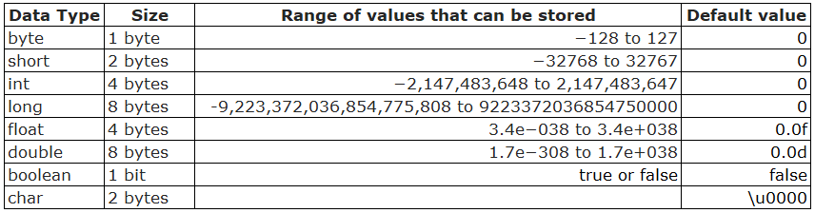
Quiz:
Storing the day of the week?
1 bit
4 bits
8 bits
16 bits
32 bits
64 bits
128 bits
256 bits
Notes:
B – 4 bits

Slide 34
Quiz:
Number of people in the world?
1 bit
4 bits
8 bits
16 bits
32 bits
64 bits
128 bits
256 bits
Notes:
F – 64 bits

Slide 35
Quiz:
Number of stars in the universe?
1 bit
4 bits
8 bits
16 bits
32 bits
64 bits
128 bits
256 bits
Notes:
G – 128 bits

Slide 36
Two’s complement – Negative #’s
A byte contains 8 bits and represents integers in the range:
-128 to 127
But how can we represent -128, -64, -1 etc. using 0 and 1? This is achieved using Two’s complement. With 8 bits we can represent 256 unique integers (whole numbers). So if we are only representing 0 and 127 positive integers (which we need 7 bits for) then we can represent the other -128 to -1 with the other 7 bits since 2⁷ + 2⁷ = 2 x 2⁷ = 2⁸.

Slide 37
Two’s complement – Negative #’s
Two's complement is the way modern computer represent integers. Process:
Convert the number to binary (don't use a sign bit, and pretend it is a positive number).
Invert all the digits (i.e. change 0's to 1's and 1's to 0's).
Add 1 to the result (Adding 1 is easy in binary; you could do it by converting to decimal first, but think carefully about what happens when a binary number is incremented by 1 by trying a few; there are more hints in the panel below).

Slide 38
Two’s complement – Negative #’s
Two's complement is the way modern computer represent integers. Process:
Convert the number to binary
Invert all the digits
Add 1 to the result
e.g. Decimal = -110:
Binary for +110 = 01101110
Inverted = 10010001
10010001 + 1 = 10010010
Check: 01101110 + 10010010 = 100000000, but only 8 bits so 0.

Slide 39
Decimal number representation
For integers we can use whole binary numbers and represent using positive powers of 2, e.g. 2⁷, but for decimals we need to use negative powers, since in base 10:
2⁻¹ = 1 / 2 = 0.5
2⁻² = 1 / 2² = 1 / 4 = 0.25
3⁻³ = 1 / 3³ = 1 / 27 = 0.037…
So working in base 2 with only 0 and 1:
Base 2. Base 1
0.1 = 2⁻¹ = 0.5
0.111 = 1 x 2⁻¹ + 1 x 2⁻² + 1 x 2⁻³ = 0.5+0.25+0.125 = 0.875
0.10001 = 1 x 2⁻¹ + 1 x 2⁻⁵ = 0.5 + 0.03125 = 0.53125

Slide 40
Decimal number representation
For integers we can use whole binary numbers and represent using positive powers of 2, e.g. 2⁷, but for decimals we need to use negative powers, since in base 10:
2⁻¹ = 1 / 2 = 0.5
2⁻² = 1 / 2² = 1 / 4 = 0.25
3⁻³ = 1 / 3³ = 1 / 27 = 0.037…
Convert the following to base 10:
1101.01 = 13.25
11.001 = 3.125
10.0011 = 2.1875

Slide 41
Demystifying Employability Skills

Slide 42
Notes:
End of lecture.

Slide 43
Representing Text: ASCII and Unicode
Not only does the computer not understand the (decimal) numbers you use, it doesn't even understand letters like "ABCDEFG...". The fact is, it doesn't care. Whatever letters you input into the computer, the computer just saves it there and delivers to you when you instruct it so.
It saves these letters in the same Binary format as digits, in accordance to a pattern.
ASCII and Unicode are the 2 most common codes in use.
ASCII: 7 bit code allowing 128 characters.
Unicode: 16 bit code allowing 2¹⁶ = 65536 characters.

Slide 44
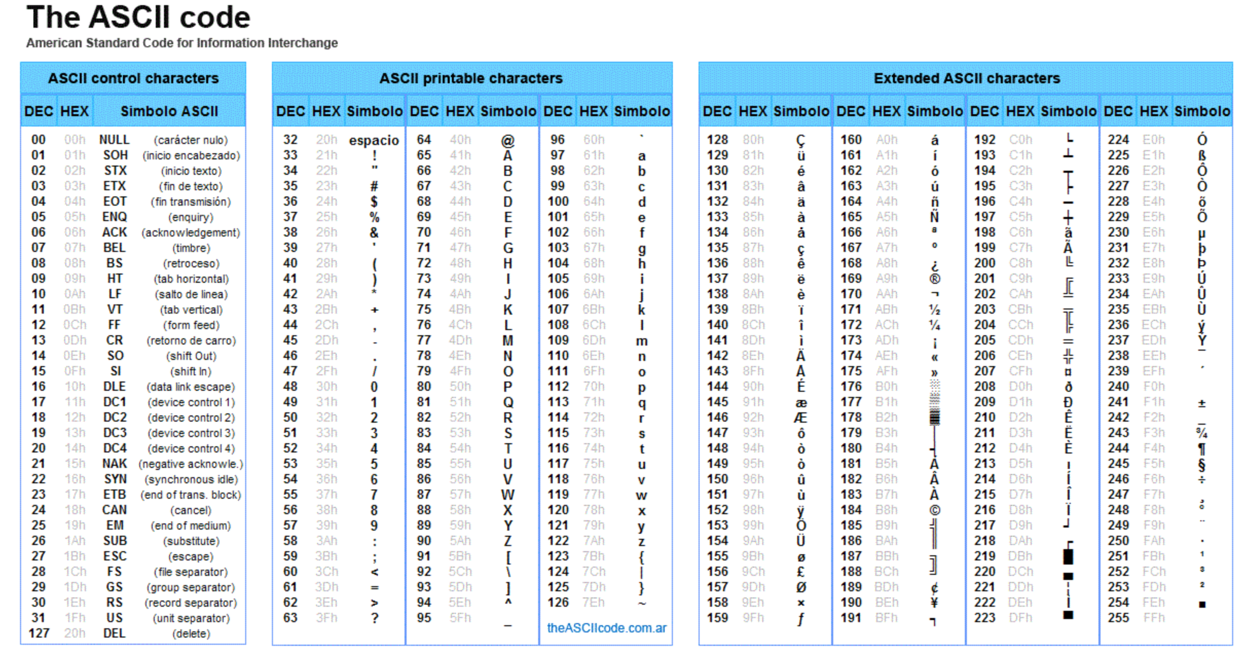
Representing Text: ASCII and Unicode

Slide 45
Representing Text: ASCII Format
Convert to ASCII:
science
Wellington
358
01110011 01100011 01101001 01100101 01101110 01100011 01100101
01010111 01100101 01101100 01101100 01101001 01101110 01100111 01110100 01101111 01101110
00110011 00110101 00111000

Slide 46
Other Text Representations
Representation
ASCII
UTF-8
UTF-16
UTF-32
Length Type
Fixed
Variable
Variable
Fixed
Bits/Character
8
8,16,24 or 32
16 or 32
32
Usage
Now Uncommon
Very Common
Common
Rare

Slide 47
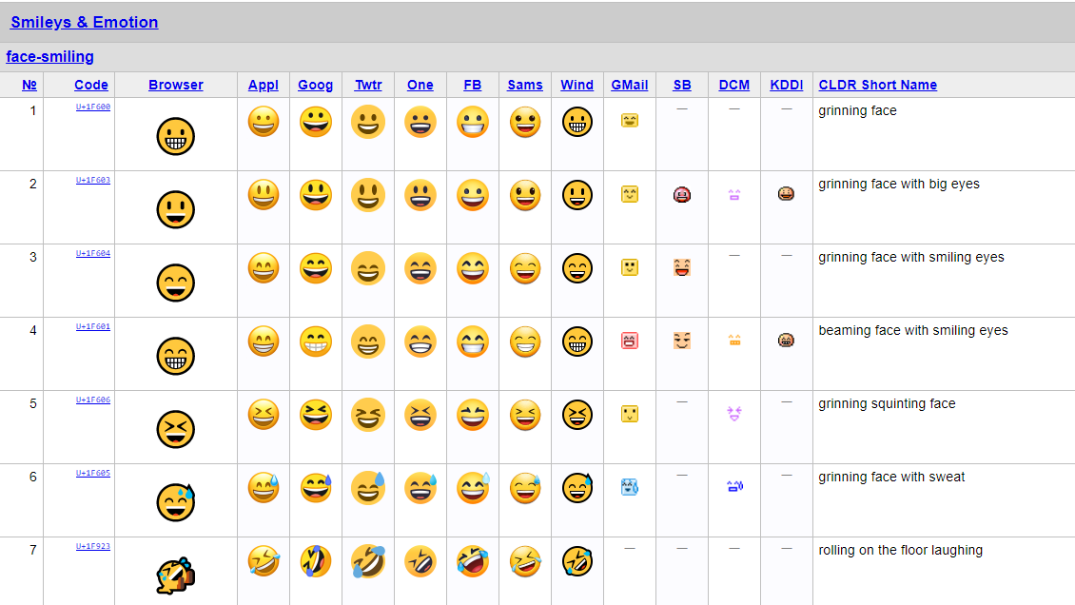
Emoji?

Slide 48
Primitive Data Types in Python
These are the most primitive or the basic data structures. They are the building blocks for data manipulation and contain pure, simple values of a data.
Python has four primitive variable types:
Integers
Float
Strings
Boolean

Slide 49
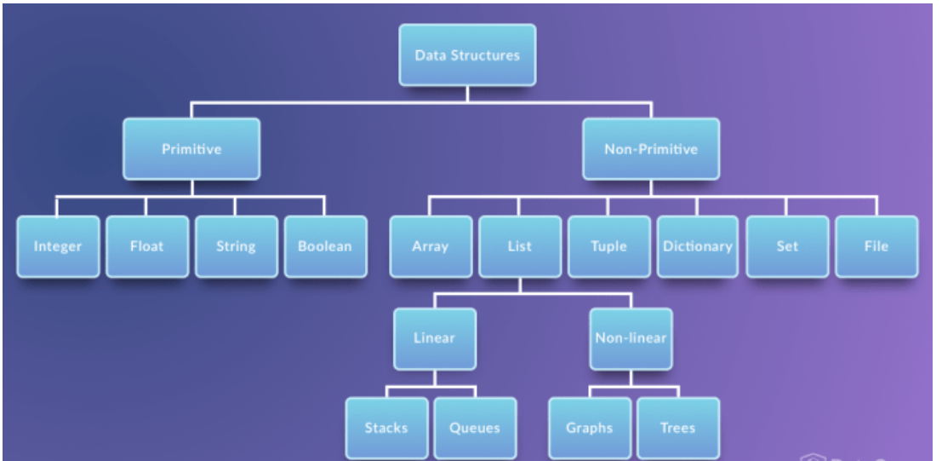
Primitive Data Types in Python

Slide 50
Booleans
A Boolean is a type of data with two possible values; True and False. Almost every programming language has Booleans, because they’re necessary for the checks, comparisons and other logical conditions in if/else statements and loops.
In python the following logical checks will return Booleans:
1 + 1 == 2
8000 > 9000
‘Hello, world!’.startswith(‘Hello’)
For x = 14 what will the following condition return; x>=0 and x<=10?

Slide 51
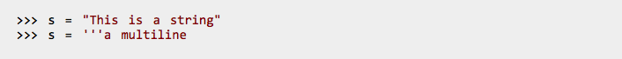
Strings
A String is a sequence of Unicode characters. We can use single quotes or double quotes to represent strings. Multi-line strings can be denoted using triple quotes, ‘’’ or ”””.

Slide 52

Strings
Integers, floating point numbers and complex numbers fall under the Python numbers category. They are defined as int, float and complex class in Python. Complex numbers contain a real part (any standard non-recurring number with or without a decimal part) and an imaginary part. An imaginary number, j or i, is given by $\sqrt{−1}$ which has a wide range of applications in computing.
We can use the type() function to know which class a variable or a value belongs to and the isinstance() function to check if an object belongs to a particular class.

Slide 53
Notes:
End of lecture.

